Slide 1
Introduction to OOPS
In Java

Slide 2
OOPS
The language like C, pascal, Fortran etc are called Procedure Oriented Programming language.
Procedures or functions to perform a task.
Program will be divided the tasks into separate sub tasks.
Each sub task is expressed as a function.
C generally contains several functions which are called and controlled from main() function

Slide 3
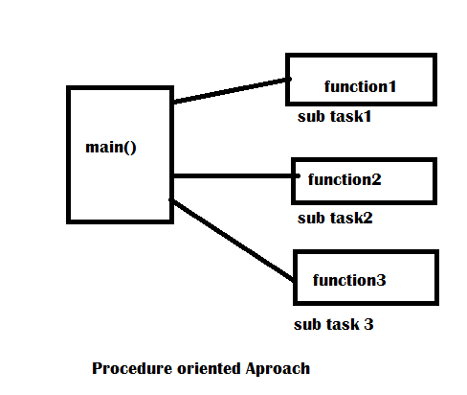

Slide 4
Object Oriented Approach
C++ and Java use classes and objects in their program and are called object oriented.
A class is a module which itself contain data and methods to achieve the task.
The main task is divided into several modules and these are represented as classes.
Each class can perform some tasks for which several methods are written in class

Slide 5
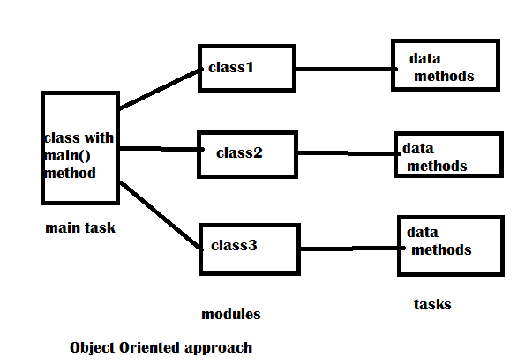

Slide 6
Problems with Procedure Oriented
There is no reusability of the previously written function.
Very difficult to handle the code after reaching thousands of line.
Debugging is very difficult in the complex programs

Slide 7
Features of Object Oriented Programming System.(OOPS)
There are many features related to OOPS.
More important is are:
Class/Object
Encapsulation
Abstraction
Inheritance
Polymorphism

Slide 8
Object
The entire OOP methodology has been derived from a single root concept called “Object”.
An object is anything that really exist in the world and can be distinguished from others.
Everything in the world is an object.
Then what is not object?
Something which is not exists really.
Ex: thoughts, imagination, plans, ideas etc

Slide 9
Every object has properties and can perfrom certain actions.
Lets us take person name Raju.
Raju has properties name,age and gender etc.
Actions like taking,eating, sleeping.
It is possible that some objects may have similar properties and actions.
Ex: Ravi, sita, Vijay etc.
All these are belong to same class called “Person”.

Slide 10
Now observe that Person is not physically exist but Raju, sita, vijay etc are exist physically.
Interview question:
Whjat is the difference between a class and an object?
A class is a model for creating objects and doesn’t exist physically.
An object is anything that exist physically.
Both the class and objects contains variables and methods.

Slide 11
Creating class and object
Class Person{
String name;
Int age;
Void talk(){ }
Void eat(){}
}
Object creating
Person Raju= new Person();---memory allocated on heap by JVM

Slide 12
Encapsulation
Encapsulation is a mechanism where the data(variables) and code(methods) that will bind together.
The variables and methods of class are called members of class.
The variables in the class are declared by using keyword “private”
The variables are not directly available to any other class.
The methods of class are declared as public. This mean methods can be called and used outside the class.

Slide 13
To use the variable from outside the class and we can take help of methods.
There is no other way of interacting the variables.
This means outsiders don’t know what variables are declared inside the class and what code is written in the methods.
Only we can use them and obtain results.
Thus Encapsulation thus protects the inner implementation of the members of the class from outside environment.

Slide 14
Encapsulation isolates the members of a class from the members of another class.
The reason is when objects are created, each object shares different memory and hence there will not be any overwriting of data.
This gives an advantage to the programmer to use same names for the members of different classes.

Slide 15
Encapsulation in Java.
In we write num=100;
After some statements num=200;
Now which value will be available in num? obviously 200.
This means previous data is lost.
Some times in software project, especially when the data is important.
Two programmers may use the same names for two variables and store different data.
Then one programmers data will be lost or modified.

Slide 16
This problem is solved with the concept of encapsulation.
According to encapsulation, a class protects its own members, So even though same names are used the members of two different classes, there will not be any overwriting or losing data.

Slide 17
Program
Class Employee{
Int id=1001;
String name=“Vishal”;
Void display()
{
System.out.Println(“Id=“+Id);
System.out.Println(“Name=“+name);
}
Class Student{
Int id=101;
String name=“Ramya”;
Void display()
{
System.out.Println(“Id=“+Id)
System.out.Println(“Name=“+name);
}

Slide 18
Abstraction
There may be a lot of data, a class contains,
User doesn’t need the entire data.
The user requires only some part of the available data.
In this case, we can hide the unnecessary data from the user and expose only that is of interest to the user called Data Abstraction.
The advantage of abstraction is that every user will get his own view of data according to the requirement and will not get confused with unnecessary data.

Slide 19
Program
package com.InputOutput.in;
class Bank{
private int accountno=10221463;
private String name="Ravi";
private float balance=2500;
private float profit=3500;
private float loan=50000;
public void display_to_clerk()
{
System.out.println("Account no ="+accountno);
System.out.println("Name ="+name);
System.out.println("Balance ="+balance);
}
}
public class Abstraction {
public static void main(String[] args) {
// TODO Auto-generated method stub
Bank b = new Bank();
b.display_to_clerk();
}
}

Slide 20
Inheritance
It creates new classes from the existing classes, so that the new class will acquire all the features the existing classes is called Inhertitance.
Lets class A having some variables and methods.
Class B wants almost same features, then we can derive
Class B extends A
{
}

Slide 21
Now all the features of A are available to B.
If an object to B is created, it contains all the members of classes A and also its own members.
Programmer can access all the members of both A and class B.
Class A is super class
Class B is sub class.
Three advantages:
We can create more useful classes needed by the software
Creating of new classes is very easy.
Managing the code becomes easy.

Slide 22
Program
package com.oops.in;
class Calculation {
int z;
public void addition(int x, int y) {
z = x + y;
System.out.println("The sum of the given numbers:"+z);
}
public void Subtraction(int x, int y) {
z = x - y;
System.out.println("The difference between the given numbers:"+z);
}
}
public class Inheritance extends Calculation {
public void multiplication(int x, int y) {
z = x * y;
System.out.println("The product of the given numbers:"+z);
}
public static void main(String[] args) {
// TODO Auto-generated method stub
int a = 20, b = 10;
Inheritance demo = new Inheritance();
demo.addition(a, b);
demo.Subtraction(a, b);
demo.multiplication(a, b);
}
}

Slide 23
PolyMorphism
Polymorphism came from two greek words
Poly means ‘many’ and morphos means forms
We can use a single variable to refer to objects to assume several different forms.
Polymorphism provides flexibility in writing programs in such a way the programmer uses same method call to perform different operations depends on the requirement.

Slide 24
Class One{
Void calculate(int x)
System.out.println(“Square value =”+(x*x)); }
Class Two extends One{
Void calculate(int x)
System.out.println(“Cube value =”+(x*x*x)); }
Let us take obj1 and obj2 are objects of classes One and Two.
One ref;
ref=obj1;
ref.calculate(2)– calculates square.
ref=obj2;
Ref.calculate(2)– calculate cube.

